Slide 1
Spectral Clustering
Implementation and Analysis
AOE 4404: Final Project
Ethan Gaebel
M.S. candidate
Computer Science and Applications

Slide 2
Outline
Clustering
Clustering as a Graph Problem
Spectral Graph Theory
Spectral Clustering
Problem Statement
Numerical Methods
Preliminary Analysis
Evaluation on Data Sets
Conclusion
References
Source Code

Slide 3
Data Clustering
In many fields involving large data sets it is useful to group together subsets of the data to identify similarities
There are many algorithms used for clustering data

Slide 4
Data Clustering Difficulties
Compactness vs Connectivity
  Compact clusters span a small area and are densely populated by data points
    Usually use distance metrics to determine cluster membership
  Connected clusters are often found in irregular shapes
    Usually rely on constructing a graph (as in graph theory, G = (V, E), where V is a set of vertices and E a set of edges) based on some measure of closeness between points
      More elementary graph theory later

Slide 5
Different View of Problem
Instead of clustering data points based on distance we could cluster them based on similarity, or closeness
We can represent these relationships with a graph, which we represent with an adjacency matrix

Slide 6
A Brief Intro to Graph Theory
Visually graphs are often represented as nodes with lines between them
Mathematically it is convenient to model them as matrices, where each row and each column corresponds to a vertex
If there is a 1 at A(i, j) then there is an edge from vertex i to vertex j
Such a matrix is referred to as an Adjacency Matrix

Slide 7
A Brief Intro to Graph Theory
A graph is described as follows
  G = (V, E)
    V is a set of vertices
    E is a set of edges
      Each edge,
Graphs can be undirected where the existence of the edge (vi, vj) implies (vj, vi)
  All the graphs we will work with here will be undirected
Graphs can be directed where (vi, vj) does not imply the existence of the edge (vj, vi)

Slide 8
A Brief Intro to Graph Theory
Visually graphs are often represented as nodes with lines between them
Mathematically it is convenient to model them as matrices, where each row and each column corresponds to a vertex
If there is a 1 at A(i, j) then there is an edge from vertex i to vertex j
Such a matrix is referred to as an Adjacency Matrix

Slide 9
Spectral Graph Theory
Spectral graph theory is a branch of graph theory that examines the relationship between the eigenvalues and eigenvectors of a graph's adjacency matrix and the underlying graph itself

Slide 10
Spectral Graph Theory
Spectral graph theory takes special interest in another graph matrix called the Laplacian, L
First we must introduce the diagonal matrix, D, called the degree matrix
  The degree of a vertex in a graph is the number of edges that vertex is involved with
  In the context of an adjacency matrix this means

Slide 11
Spectral Graph Theory –
The Laplacian
Recall D is the degree matrix and A is the adjacency matrix
The unnormalized Laplacian is defined as:
  L = D – A
The Laplacian has the very useful property that for every vector f
Making the Laplacian a positive semi-definite matrix

Slide 12
Spectral Graph Theory –
Properties of The Laplacian
A few more useful properties of the Laplacian (L) are
  L is symmetric
  The smallest eigenvalue of L is 0 and the corresponding eigenvector is the 1 vector (more generally, a vector having all the same values)
  All eigenvalues of L are real-valued and non-negative
These properties are useful for the linear algebra techniques we will use later

Slide 13
Spectral Graph Theory –
Using the Laplacian
So how does this serve our interest in clustering?
Translating our data into a graph creates several sub-graphs (depending on how we create our similarity matrix)
  These sub-graphs contain mapped data points which are similar, so we have our clustering!
  We just perform a mapping back to our original data set to cluster our points
How do we create our similarity matrix?

Slide 14
Constructing the Similarity Matrix
Nearest Neighbor – compare each pair of data points and determine the following:
If this is true we place a edge between the two data points in the similarity graph, a 1 in the similarity matrix, otherwise we insert a 0
Gaussian Kernel – For dimensions > 1 the Gaussian kernel is a regular product of one-dimensional Gaussians; making it separable. This property is useful to us so we compute the value for each edge between our data points using the Gaussian kernel as follows:
  We omit many of the familiar constant terms since they are being applied uniformly to all of our data

Slide 15
Constructing the Similarity Matrix
Clustering results can be dependent on the values of epsilon and sigma depending on how the similarity matrix is constructed
  Careful attention must be paid to the data and the resulting clustering to ensure good results are obtained

Slide 16
Clustering On the Similarity Graph
After converting data to similarity graph representation we can use the eigenvectors to perform clustering
To do this, we create a matrix where the columns correspond to the first K eigenvectors
Then we run K-Means on the eigenvectors so that each row is treated as a data point
We obtain the clustering results and for each row in the eigenvectors data is mapped back to the corresponding row index in the data such that if row j in the eigenvectors is assigned to cluster k then row j in the data set is assigned to cluster k

Slide 17
Numerical Methods
QR Algorithm
Householder's Method
K-Means
Spectral Clustering

Slide 18
QR Algorithm
Used to compute eigenvectors and eigenvalues for the Laplacian matrix
Operates on a symmetric tridiagonal matrix, A
  Non-tridiagonal matrices are transformed using Householder's method, discussed next
Performs iterative QR factorization on the matrix A

Slide 19
Householder's Method
Repeatedly multiplies the input matrix A by an orthogonal matrix P to obtain a 'similar' matrix with the same eigenvalues while making the matrix sparse until it becomes tridiagonal
To preserve eigenvector information we must keep track of the transformations applied to A with a matrix V
  V = I;
  …
  A = PT * A * P
  V = V * P;
Accompanying QR algorithm uses this matrix to compute eigenvectors

Slide 20
K-Means
K-Means is a popular clustering algorithm which clusters data into K clusters, given a particular K
K-Means does this by solving the following minimization problem, where μ is the center (mean) of a cluster, Si, and x is a data point in that cluster

Slide 21
K-Means
As an algorithm K-means selects initial μ values (means) from the data set and iterates over all data points assigning each data point to the closest cluster by Euclidean distance
After each assignment of data point to cluster K-means updates the values for all μ
The algorithm terminates when no further updates are performed

Slide 22
K-Means Initial Means
K-Means can be very sensitive to the initial assignments of μ
Many techniques suggest random selection
Due to the nature of our data, eigenvectors over Laplacians, we see a lot of repetition in the data points being clustered on and to ensure diversity we would like to not select identical means
K-means++ is a technique to accomplish this

Slide 23
K-Means++
K-Means++ is a tool used to select higher quality initial values for μ in the K-Means algorithm
It selects an initial value for μ1 at random from the dataset
For each remaining μi K-Means++ draws a value according to the probabilities:
  Where X is the entire dataset and D is the distance to the potential μi

Slide 24
Formal Spectral Clustering Description
Spectral Clustering(X, K)
1. Compute similarity matrix W from X
2. Compute the Laplacian, L, for W
3. Find the eigenvectors and eigenvalues for L
4. Select the first K eigenvectors, μ1,μ2, … μk and form a matrix U with the K eigenvectors as columns
5. Run a clustering algorithm with U as the data set
  We use K-Means
6. Assign each data point in X to the cluster that the corresponding row in U was assigned to

Slide 25
Stability
The stability of spectral clustering is highly dependent on the parameters involved in creating the similarity matrix
Also, stability depends on the data itself, sparse or seemingly random data sets may perform badly
As stated in the previous section K-Means is susceptible to instability if initial values are chosen badly
  Using K-Means++ provides a high degree of stability among results

Slide 26
Convergence
Spectral clustering is guaranteed to converge to a solution although no guarantees regarding optimality can be made

Slide 27
Accuracy
Clustering accuracy is difficult to measure numerically
For this study we use sight-checking and ensure data presented supports this form of checking
Since clustering is often used on raw data points it can be quite intuitive which clusters are correct when looking at the data
  The problem is hard for computers and easy for humans

Slide 28
Performance Analysis
Spectral clustering was analyzed by running it on 2d and 3d data sets
Its results were compared to k-means without any spectral transformation
Many of the results show good performance and others quite poor
  This illustrates the importance of selecting the correct clustering algorithm for the correct data set

Slide 29
Evaluation
I compared K-Means to Spectral Clustering on non-convex data

Slide 30
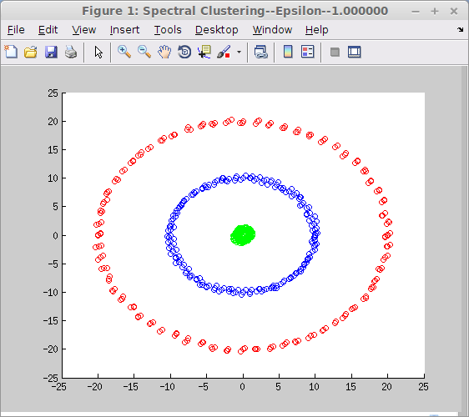
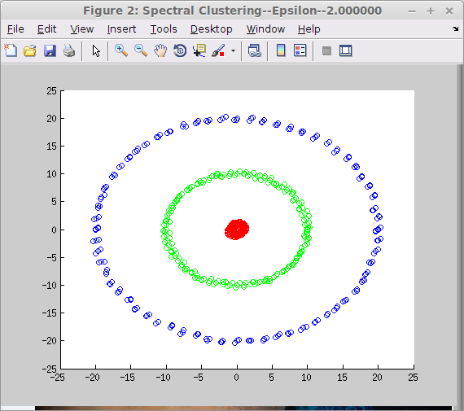
Epsilon Neighborhood

Slide 31
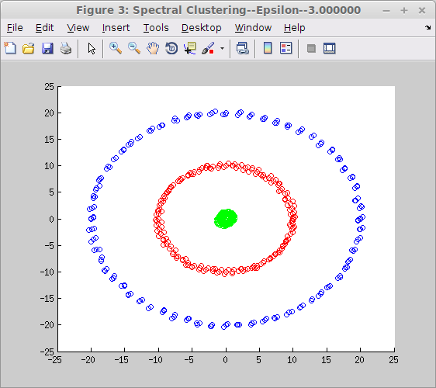
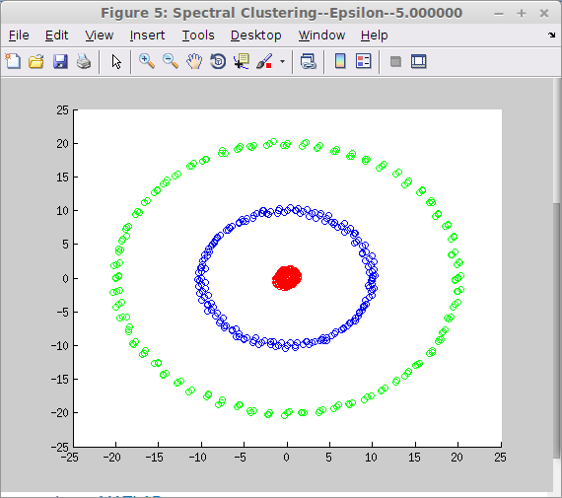
Epsilon Neighborhood

Slide 32
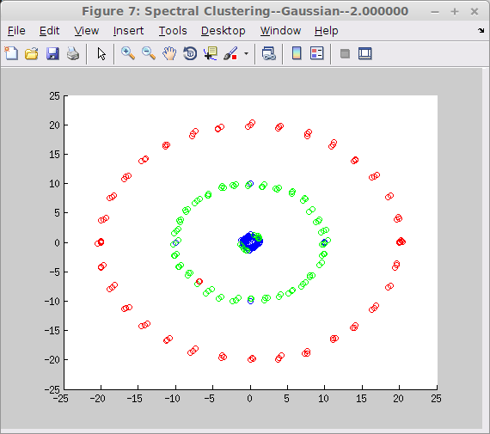
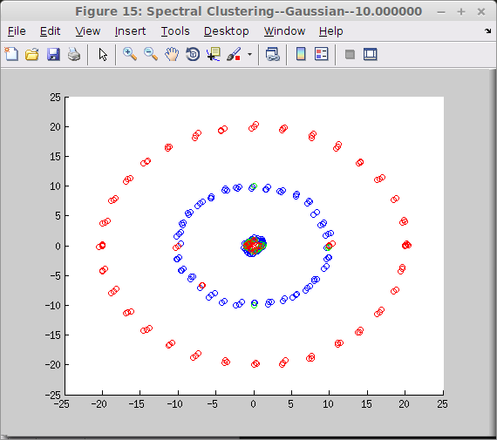
Gaussian Kernel

Slide 33
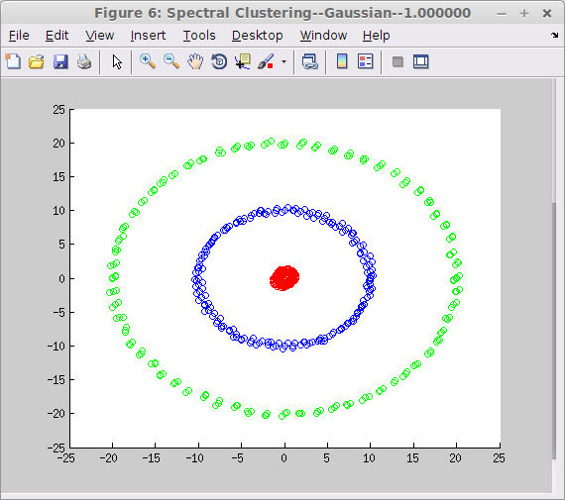
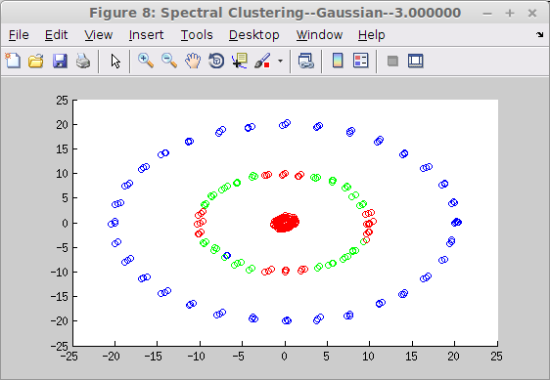
Gaussian Kernel

Slide 34
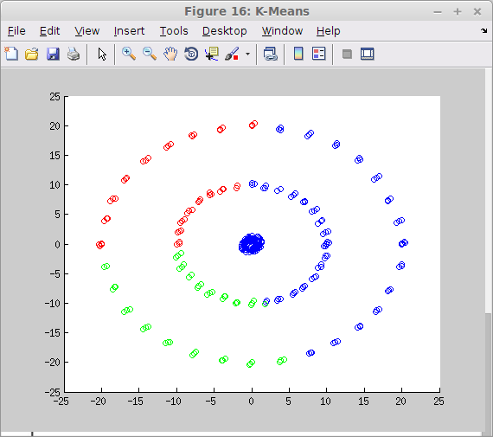
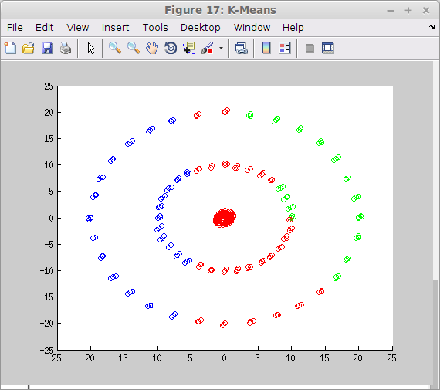
K-Means

Slide 35
Comments on Results
As expected K-Means is outperformed by spectral clustering in this instance of data being more closely associated by its relative relationship than by its global one
The epsilon neighborhood method is far more stable, providing identical clusterings across values from 1-5
The Gaussian kernel method provided noisy clusters at best and totally confused clusters at worst

Slide 36
Conclusion
Spectral clustering outperforms K-Means for cases where data is better described by its relationship to surrounding, or similar, data points
Spectral
As the data collected by researchers becomes more complex we expect to see more irregular data of this fashion which will motivate the use of spectral clustering and algorithms like it in the future

Slide 37
References
Ulrike von Luxburg, “A Tutorial on Spectral Clustering”, Max Planck Institute for Biological Cybernetics, Tubingen, Germany
David Arthur and Sergei Vassilvitskii, “k-means++: The Advantages of Careful Seeding”
Madeleine Udell, “Introduction to Spectral Graph Theory”
“The Gaussian Kernel”, http://www.stat.wisc.edu/~mchung/teaching/MIA/reading/diffusion.gaussian.kernel.pdf.pdf
“The QR Algorithm”, http://www.math.iit.edu/~fass/477577_Chapter_11.pdf
Richard L. Burden and J. Douglas Faires “Numerical Analysis” 8th Edition, Thomson

Slide 38
Source Code
All source code written for this project was done by me, Ethan Gaebel, can be found on BitBucket at:
https://bitbucket.org/egaebel/spectral-clustering-math-4404-project/src

